Slide 1


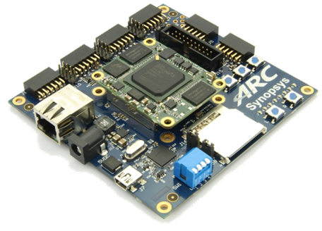
領先創新·
·超越自我
2019 Synopsys ARC盃電子設計競賽

Slide 2
SMART FIREFIGHTER
UETer
UET - VNU

Slide 3
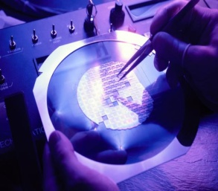
Agenda
Project Overview
System Architecture
Summary & outlook

Slide 4
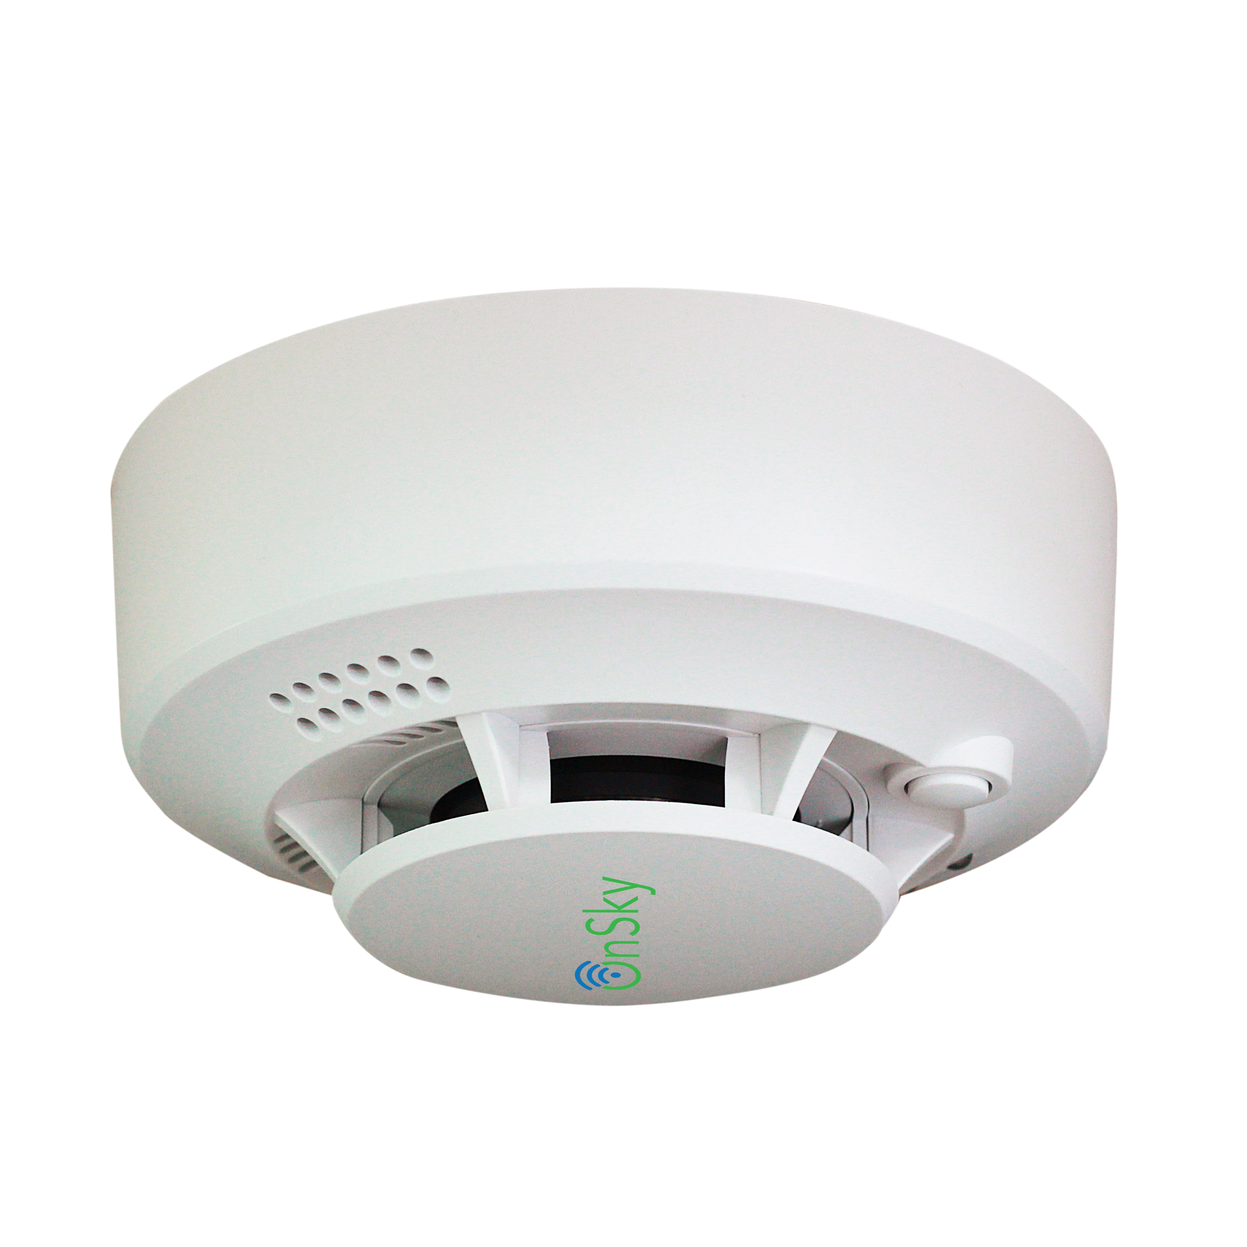
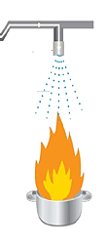
Project Overview
Classic firefighter
Smart firefighter
Quick and accurate detection of flame location.
Detect small size of flame (a candle at 3m).
Spray water flow to the fire correctly, while keeping other areas dry spear.
Can be mobility.
Smoke sensor:
Slow detection
no location of flame
Wide water spray nozzle:
Waste water
Causing damage to other furniture

Slide 5
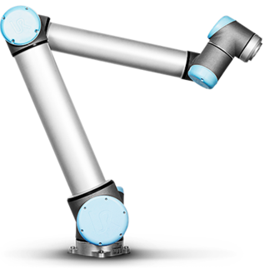
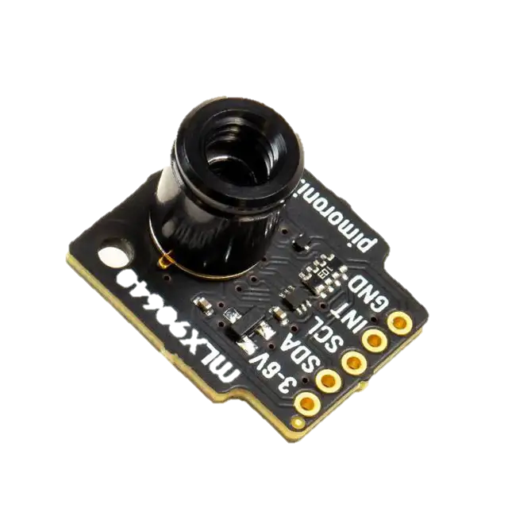
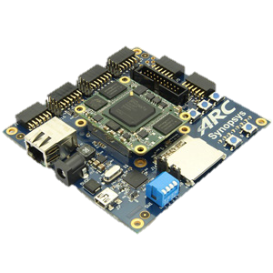

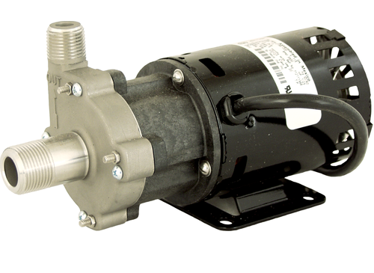
System Architecture
2 stepper motor
I2C
Move spray nozzle
Flame directions
2 axis robot arm
I2C
H bridge
Flame directions
Spray water
Calculate flame locations
Water pump
2x thermal sensor 32x24 pixel
FOV: 55°x35°

Slide 6
Flame directions - Example
4
3
2
1
-1
-2
-3
-4
 | -4 | -3 | -2 | -1 | 1 | 2 | 3 | 4
Hottest pixel: xh = 2, yh = 1
- x angle: α = (55/32)*xh
Y angle: β = (35/24)*yh
2 sensor: α₁, α₂, β₁, β₂

Slide 7
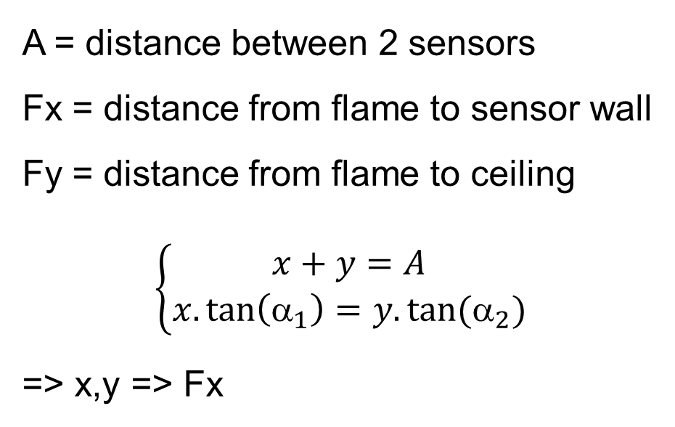
Flame directions
A = distance between 2 sensors
Fx = distance from flame to sensor wall
Fy = distance from flame to ceiling
$$\left\{\begin{matrix}x+y=A \\ x.\tan\left({\text{α}}_{1}\right)=y.tan⁡({\text{α}}_{2})\end{matrix}\right.$$
=> x,y => Fx
x_{v}
y_{v}
Fx
α₁
α₂
x
y
Sensor 1
Sensor 2

Slide 8
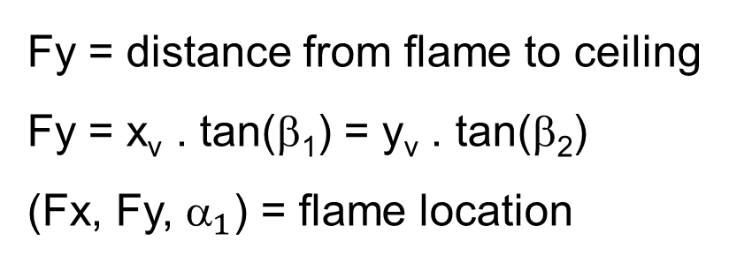
Flame location
Flame
Fy = distance from flame to ceiling
Fy = x_{v} . tan(β₁) = y_{v} . tan(β₂)
(Fx, Fy, ${\text{}}_{1}$) = flame location
Fy
β₁
x_{v}
Sensor 1

Slide 9
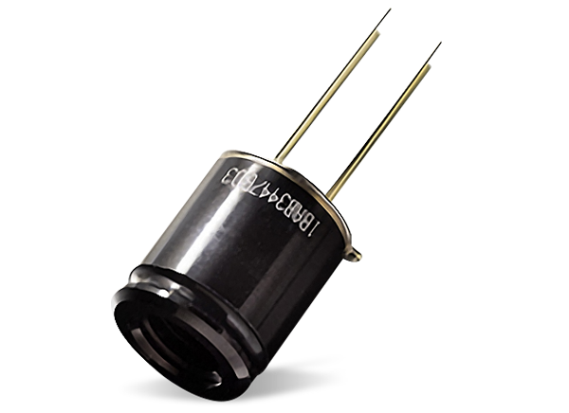
Sensor setup
45°
35°
3m

Slide 10
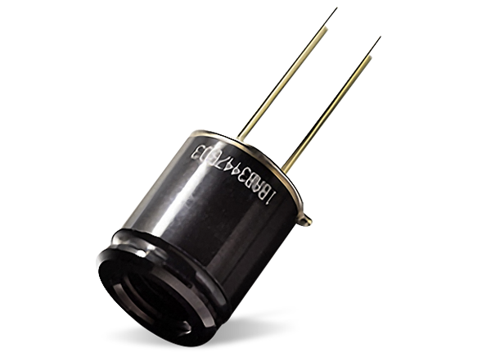
Sensor setup
Sensor covers an area 5m*5m, 3m height
5m
60°
5m * 5m

Slide 11
Outlook
Mesh Network with Multi Node
Multi sensor node.
Multi water spray
=> Extend protection area.

